Slide 1
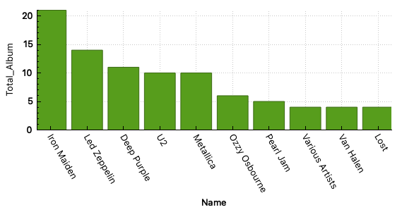
The TOP 10 Artist who recorded most Albums
<visualization>
This distribution show us the TOP 10 Artists the most recording Albums Iron Maiden" at the top with 21 albums, followed by "Led Zeppelin" with 14 albums, "Deep Purple" with 11 albums, "Metallica" and "U2" both with 10 albums, "Ozzy Osbourne" with 6 albums, "Pearl Jam" with 5 albums, and "Various Artists," "Van Halen," and "Lost" all with 4 albums each.

Slide 2
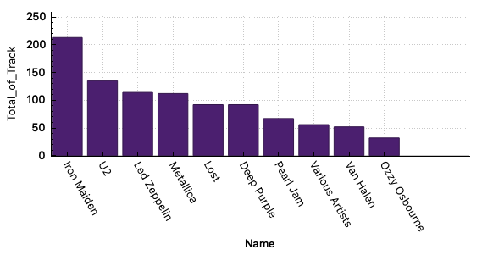
Total numbers of Track for each Artist in the TOP 10?
<visualization>
The distribution show us artists with the most having track, its shows the Artist Iron Maiden is the most with 213 tracks. In the other hand, the lowest among them is Ozzy Osbourne with 32 of tracks.

Slide 3
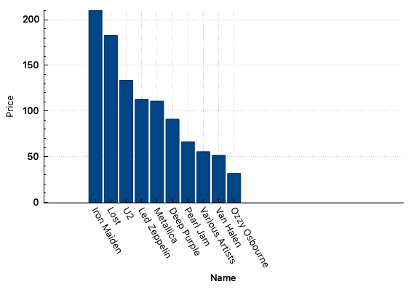
The total price of tracks for each Artist in the TOP 10
<visualization>
The distribution show us artists with most total unit price of track, its shows the Artist Iron Maiden is the most with 210.87. in the other hand, the lowest among them is Ozzy Osbourne with 31.68 .

Slide 4
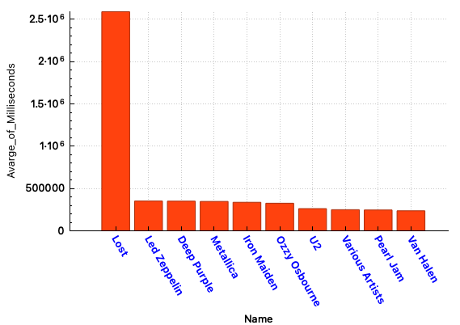
The average Milliseconds of a track for Albums for each Artist in the TOP 10
<visualization>
The distribution show us artists with average Milliseconds of track, its shows the Artist Lost is the most with 2589984.58695652 Milliseconds. In the other hand the lowest among them is Van halen with 236484.980769231
Milliseconds.

